Slide 1
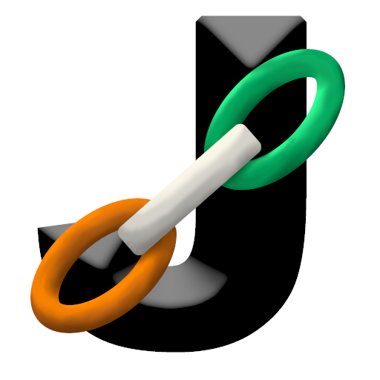

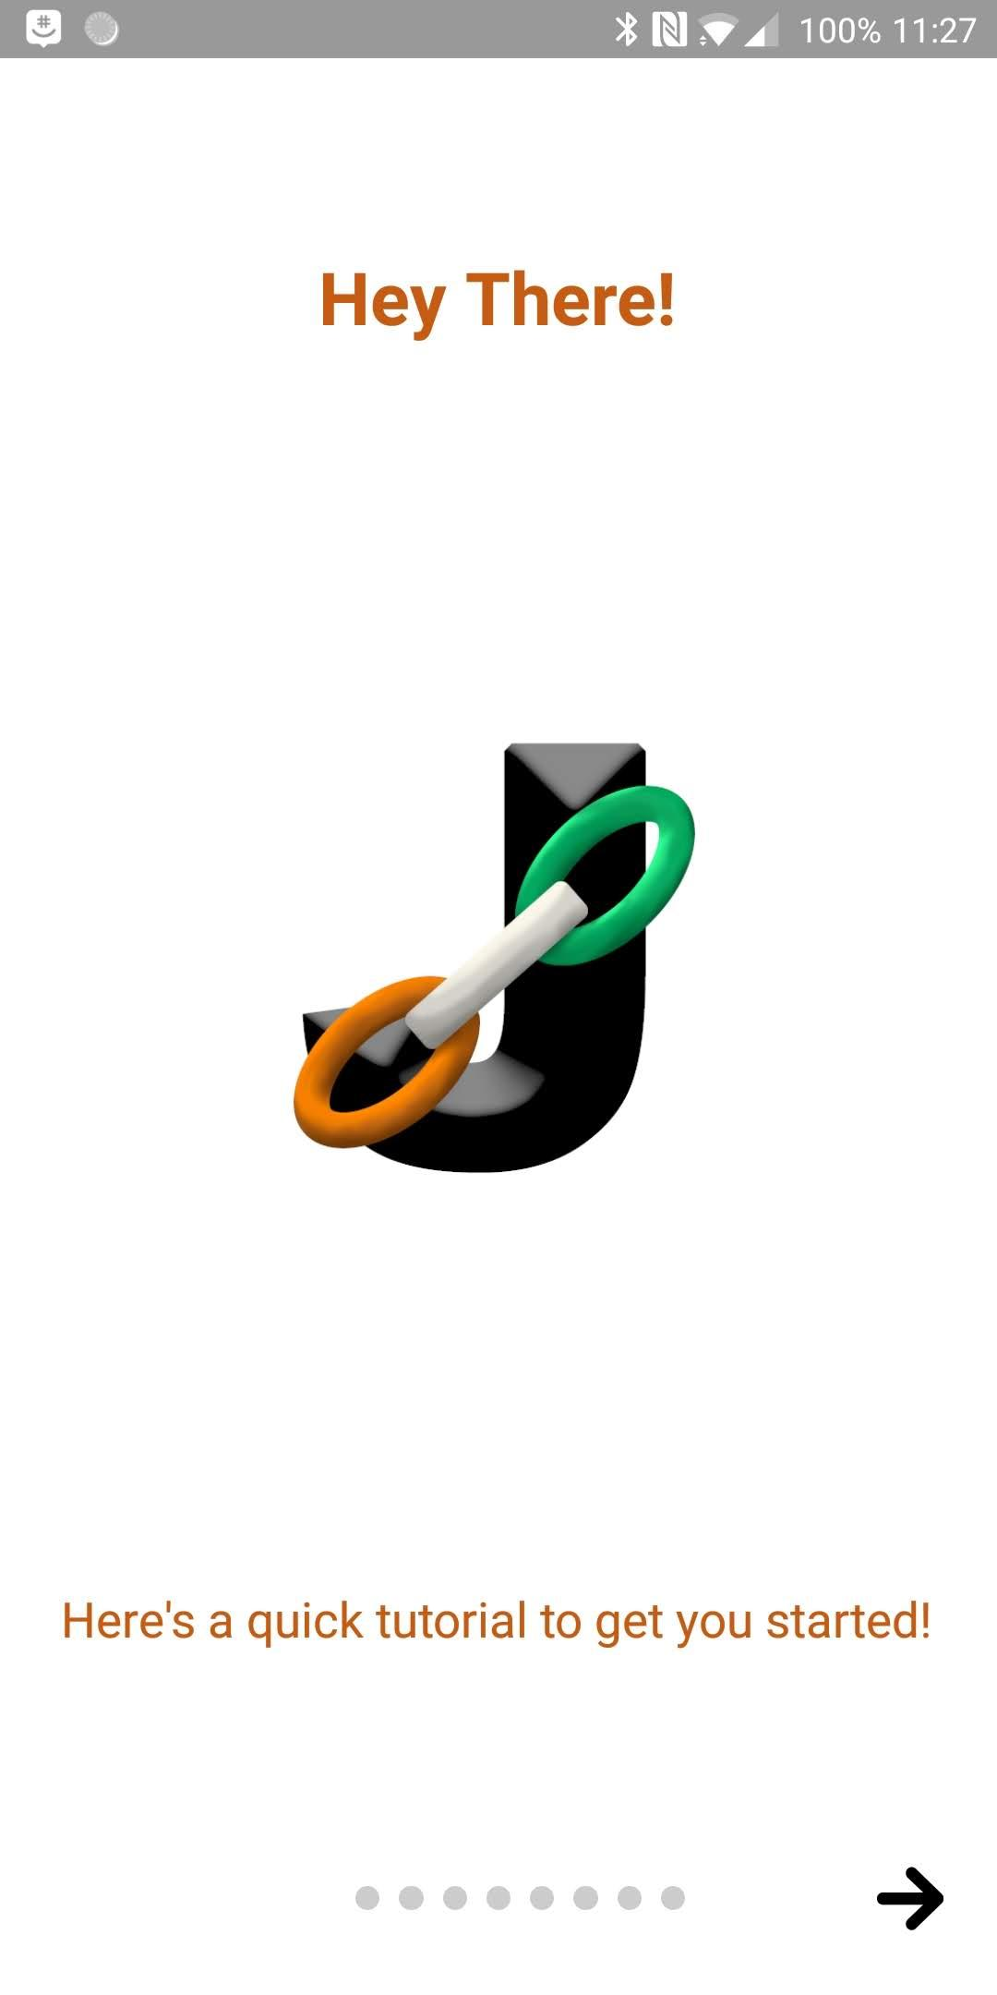
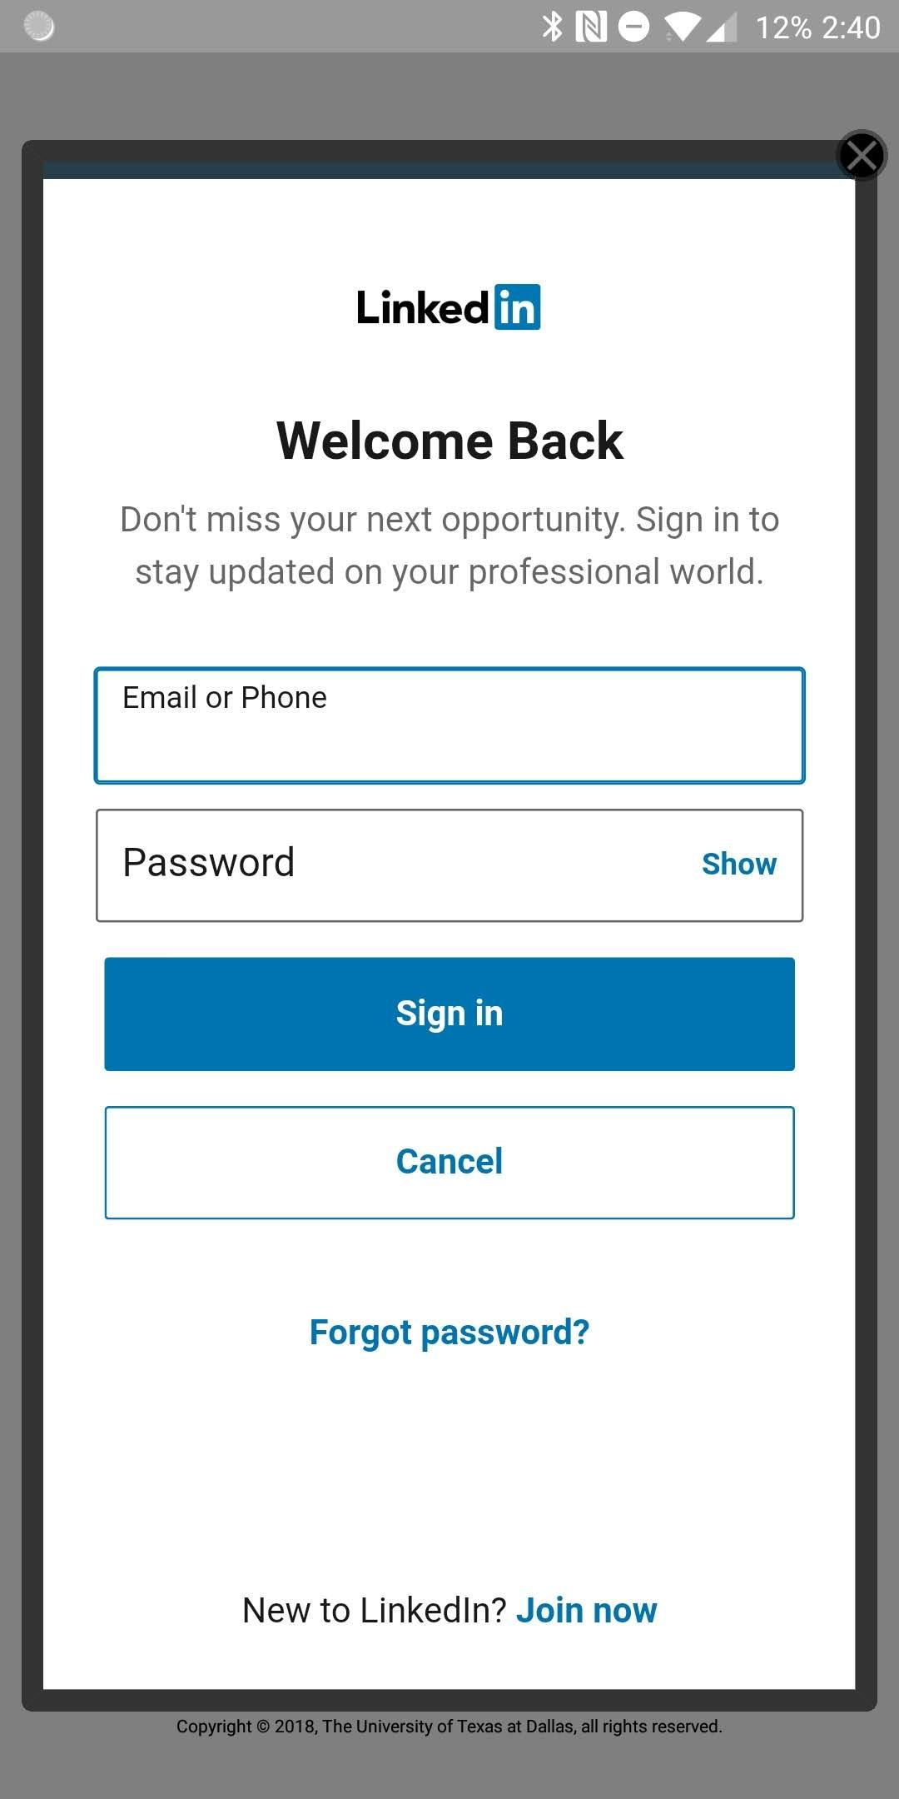
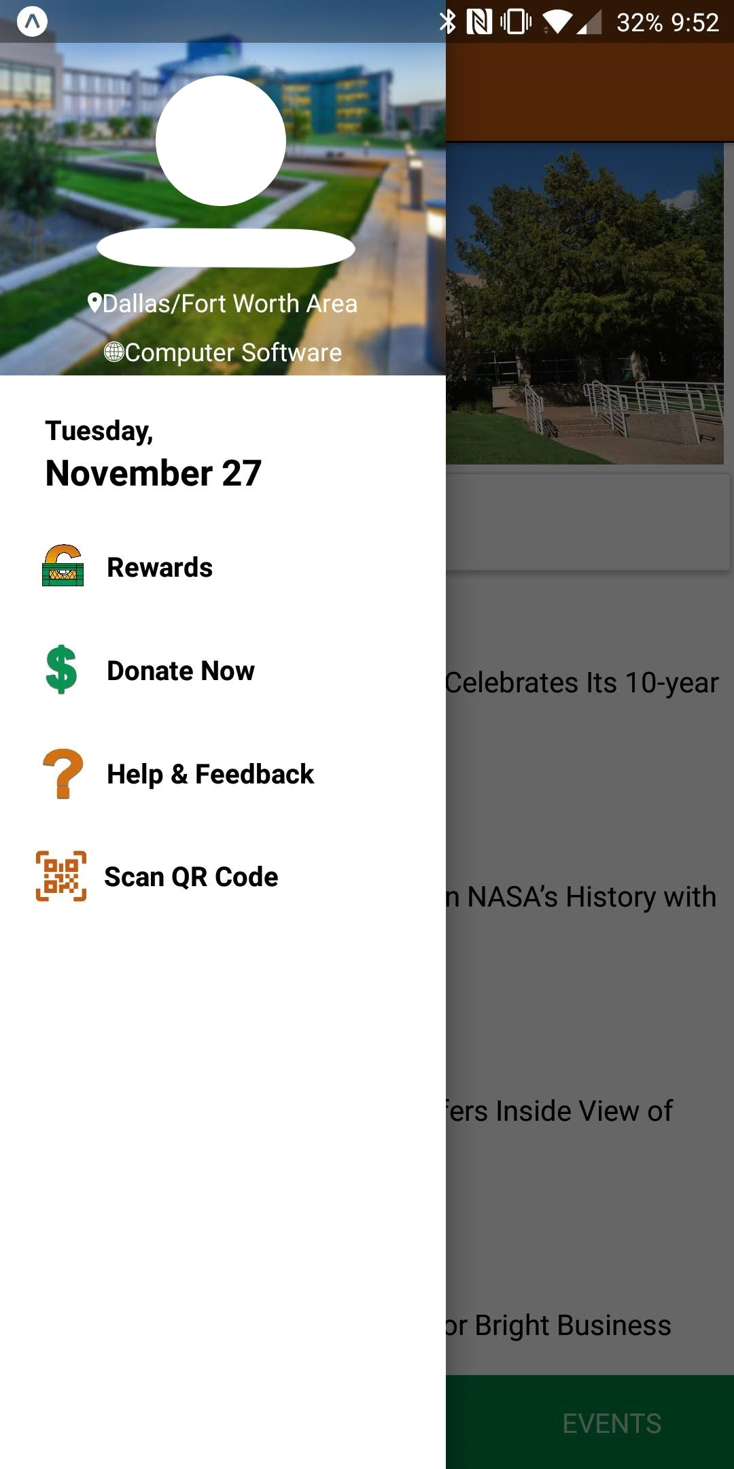
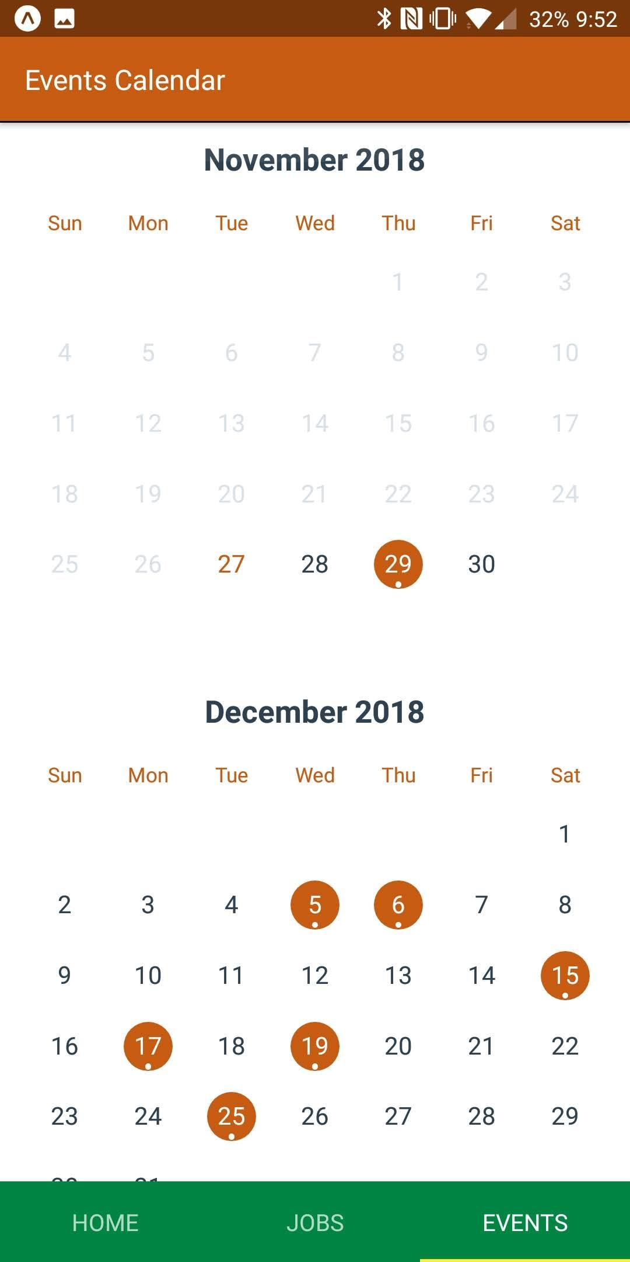
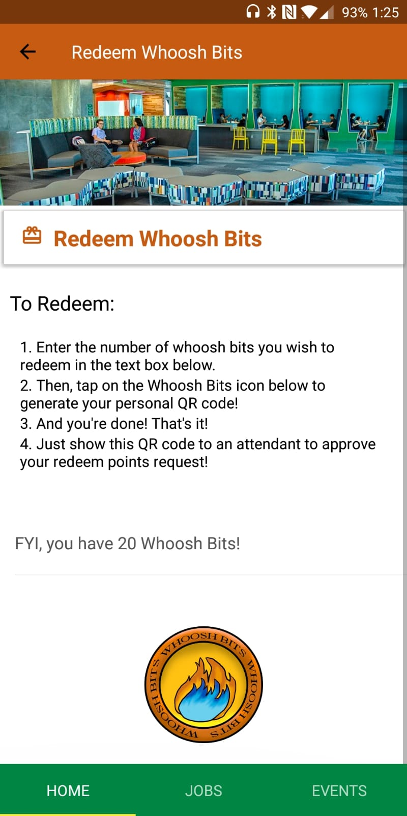
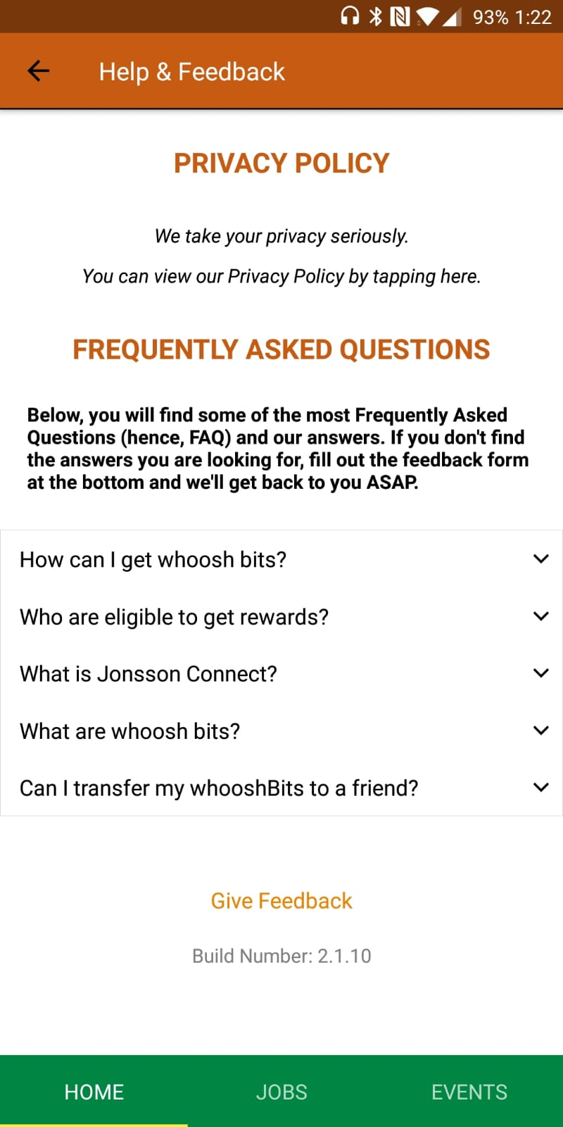
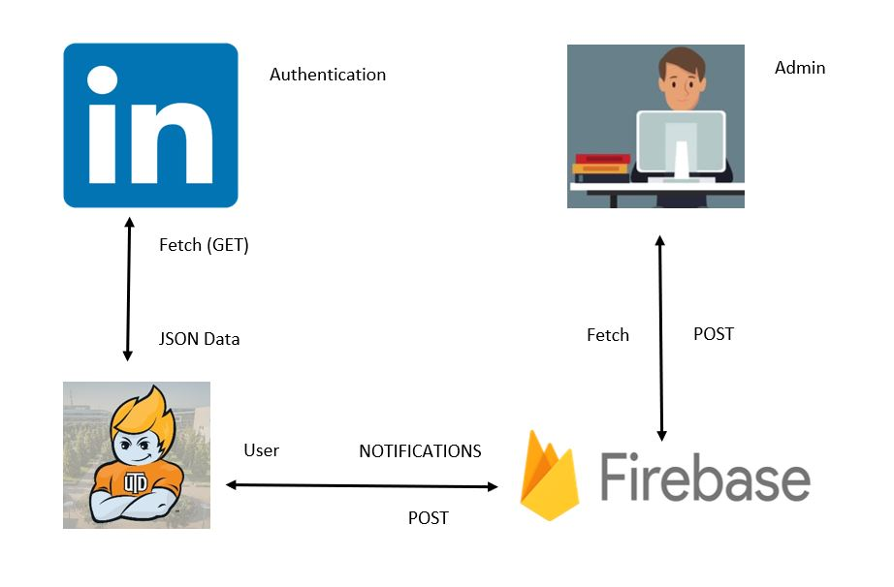
Jonsson Connect App - Phase 2
Vignesh Chandrasekharan (vignesh.chandrasekharan@utdallas.edu), Jahnavi Koparthi (jxk140930@utdallas.edu), Akshay Ramesh (axr151030@utdallas.edu), Manu Satyan (manu.satyan@utdallas.edu), Sri Lakshmi Tanneeru (srilakshmi.tanneeru@utdallas.edu)
CS 4485 - Fall 2019
Department of Computer Science
Erik Jonsson School of Engineering & Computer Science
The University of Texas at Dallas
Richardson, TX 75080
Abstract
The Jonsson Connect app will connect students, alumni, and employers with each other and the Jonsson School. Phase 2 of the Jonsson Connect App Development was primarily focused on getting the app ready for release to the public. In phase 2, we improved the existing UI, implemented a rewards system to boost student & alumni interactions with the Jonsson School, and added a feedback system that allows users to directly communicate with developers and the Jonsson School staff. By taking advantage of Expo’s free open-source toolchain and Facebook’s React Native (a framework for building native applications for Android & iOS), we avoided having to natively develop the app for the two separate platforms. Instead, we programmed in JavaScript, letting react Native convert the code into Java and Swift. On November 29th, our beta testing attracted over 60 participants who gave us invaluable feedback which we incorporated into the app.
Keywords: Mobile App, API, iOS, Android
Results
h
Architecture
Summary
h as
Impact
The Jonsson Connect App,
Provides a helpful tutorial to help out first time users
Provides a rewards system where users can scan QR codes when attending events to get Whoosh bits - These can be redeemed for comet crates (gifts).
Notifies users when new events are added via push notifications.
Includes deep-links which allow users to get directions to the event’s location in their default maps app.
An Increase in engagement of current students & alumni with the Erik Jonsson School of Engineering & Computer Science (ECS).
Effortless way of checking latest news, jobs, & events tied to ECS.
Performance
The Jonsson Connect app meets the industry’s performance standards.
Cross-platform development ensures that user experience is consistent across the Android & iOS platforms.
Users are notified of new events as soon as they are added.
Fast response times with low API latency.
Metrics
Our metrics are based on our completed requirements & cost.
We finished 100% of our MVP core requirements.
We were unable to complete an additional filtering feature.
Total Project Cost: $10.00 (Recurring monthly).

